Slide 1
Text

Slide 2
Building and Lab operations for Facility and outside vendors
Point of Operations
Alex Fonseca
Antenna Development Section Manager
5/24/2023

Slide 3
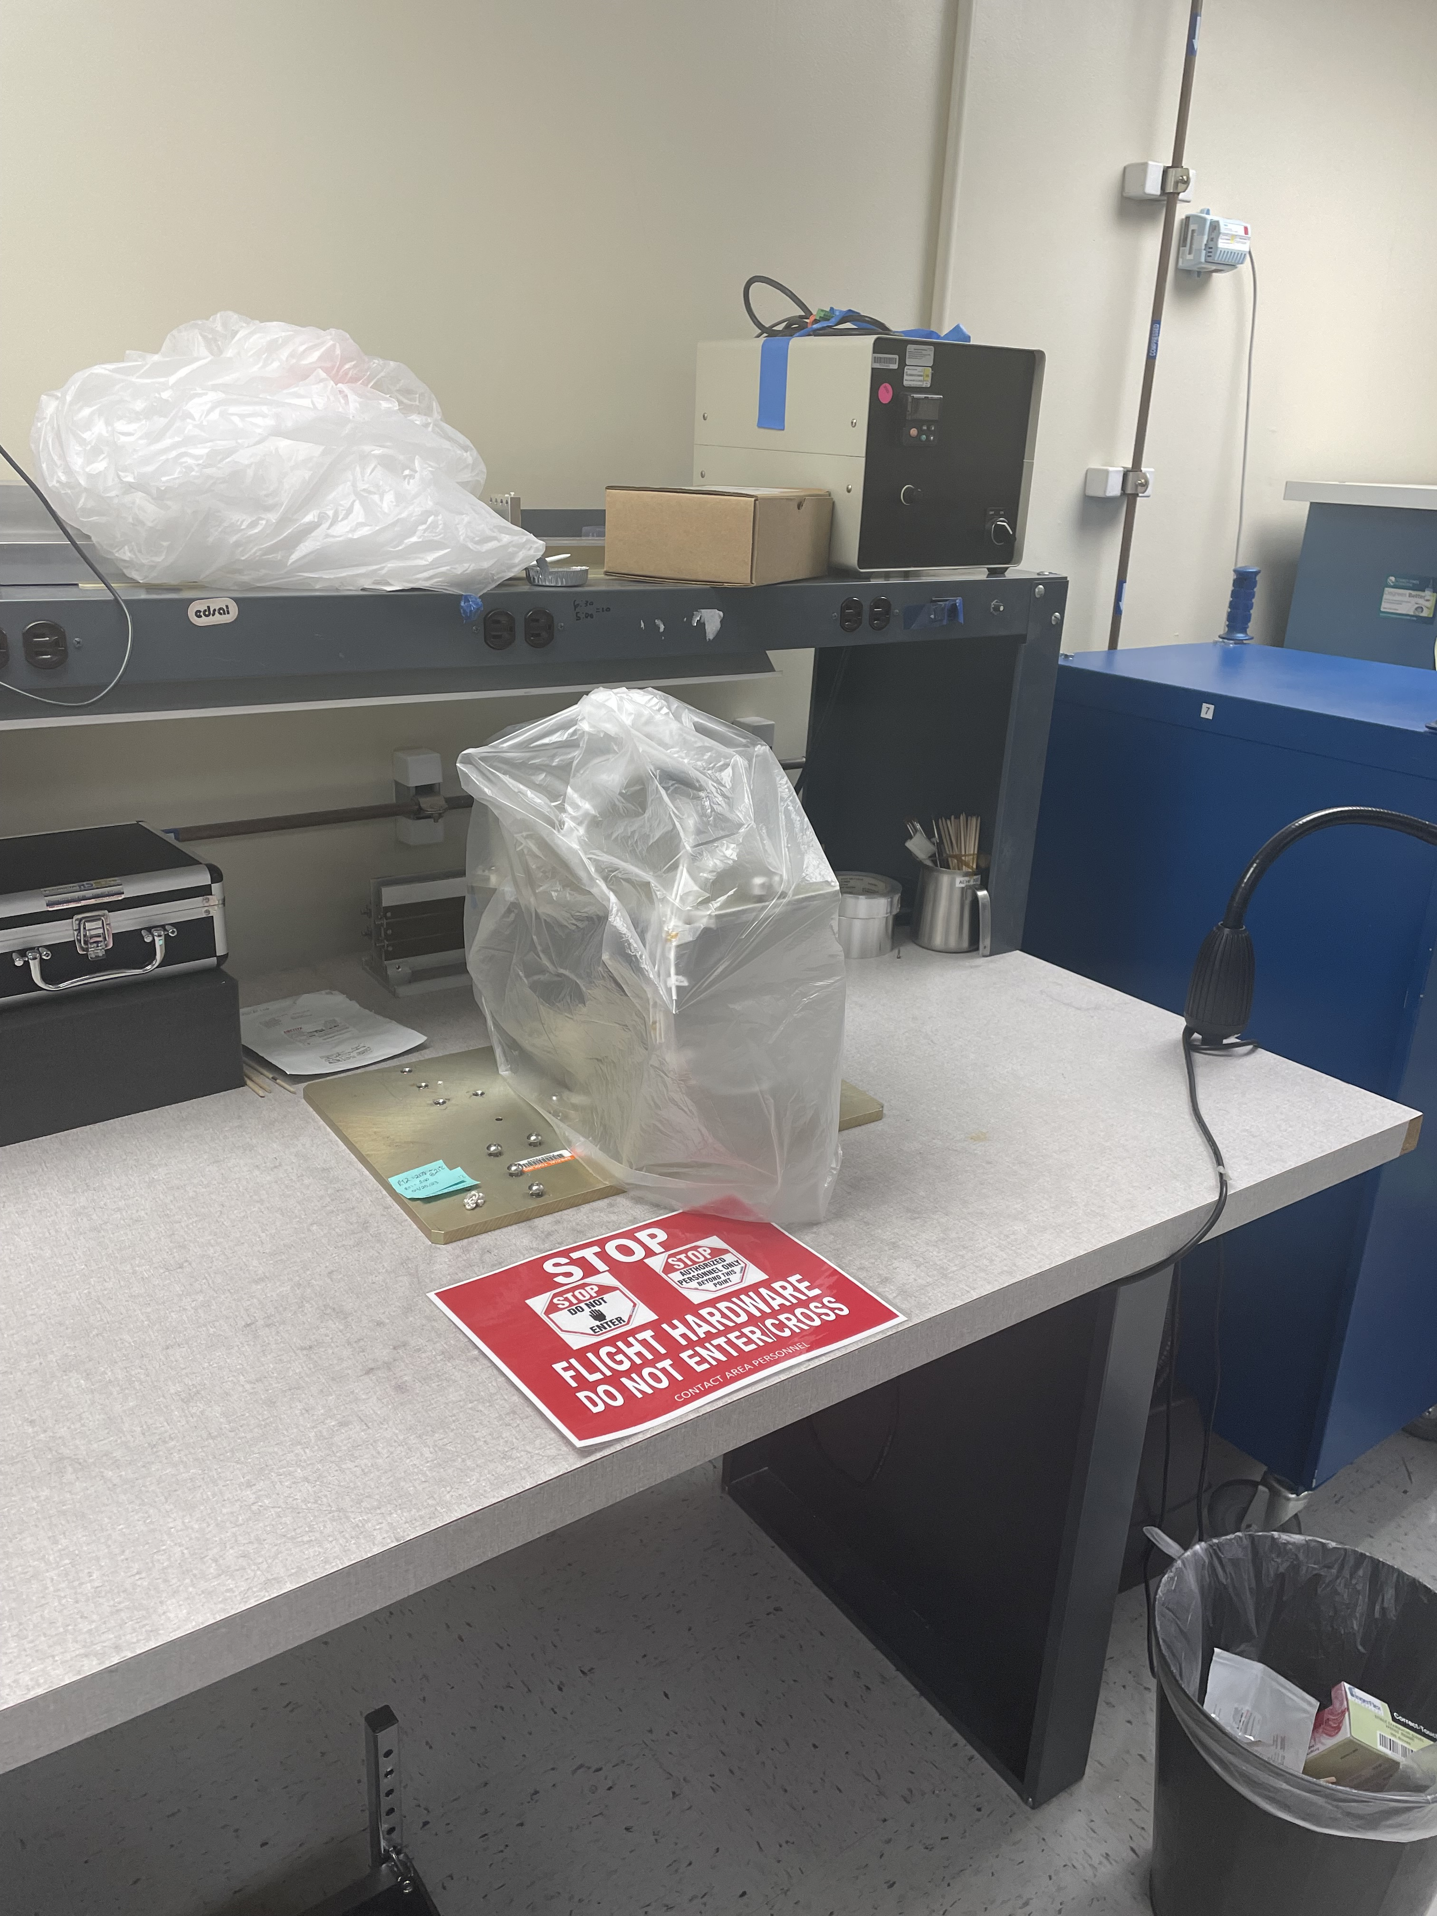
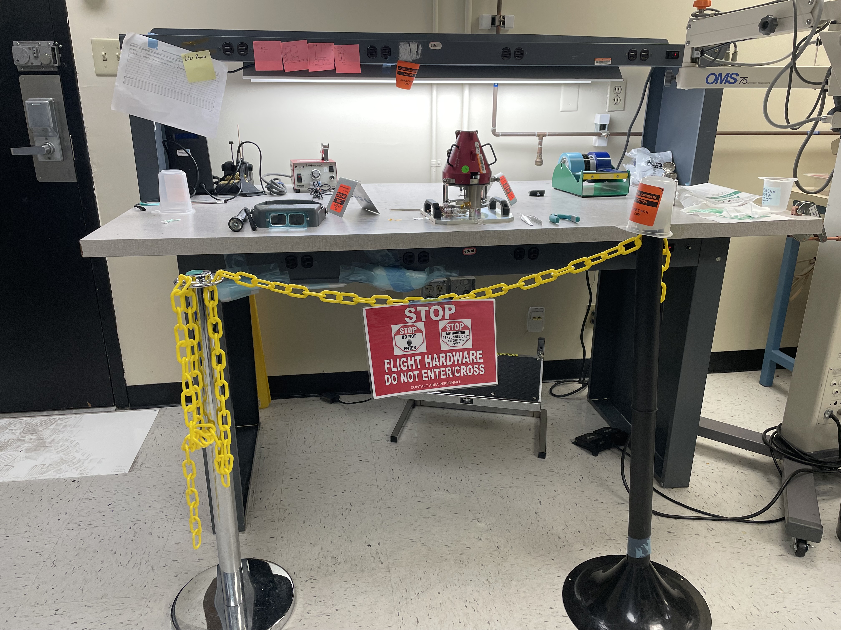
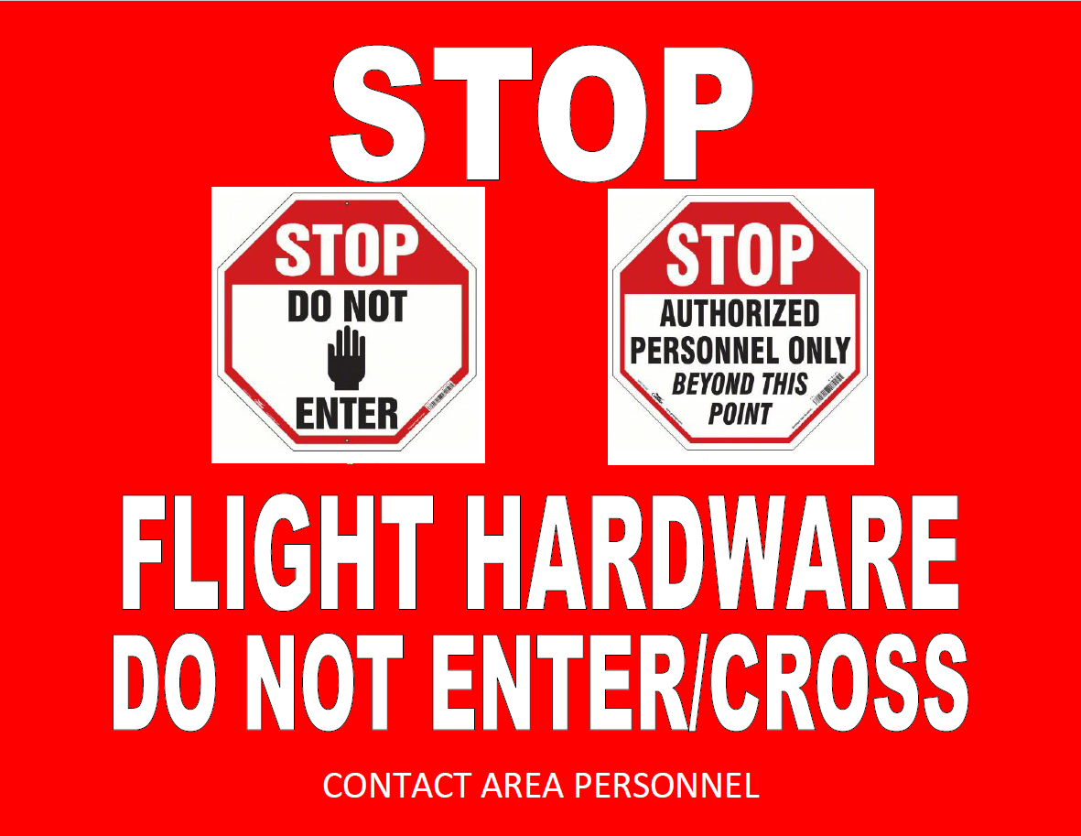
Building and Lab Facility Support Operations
EM/Non-Flight/Flight hardware come in many shapes and sizes. Be mindful of your surroundings and always try to stay at least 3ft away from hardware that may be on a work bench, table or other surfaces.
If work is around a test or assembly bench, ask area manager or area personnel if it is safe to perform work (don’t assume that there is no hardware present)
Try to schedule/coordinate work with area management ahead of time so they can clear area if possible
Do not touch or move any totes, carts, or equipment.
Adhere to any signs and stanchions posted by area personnel. Do not move or remove any stanchions. Stop and notify area personnel to gain access beyond any signage.
If work to be performed is near or around hardware, notify area personnel prior to performing work.
Example of Hardware on table
Example of stanchion with hardware present
Example of Caution sign
WHEN IN DOUBT CONTACT AREA MANAGEMENT/PERSONNEL PRIOR TO PERFORMING WORK NEAR OR AROUND HARDWARE

Slide 4
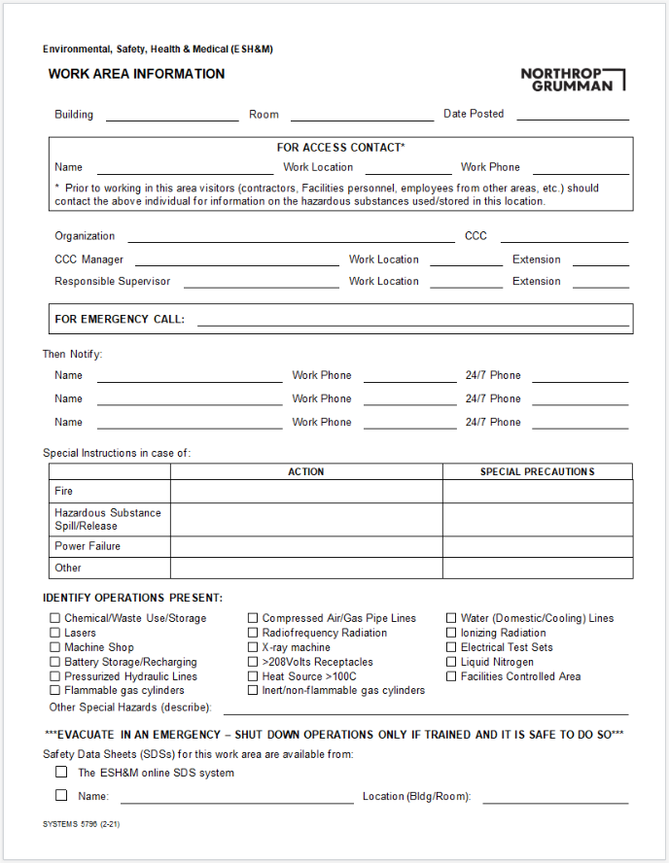
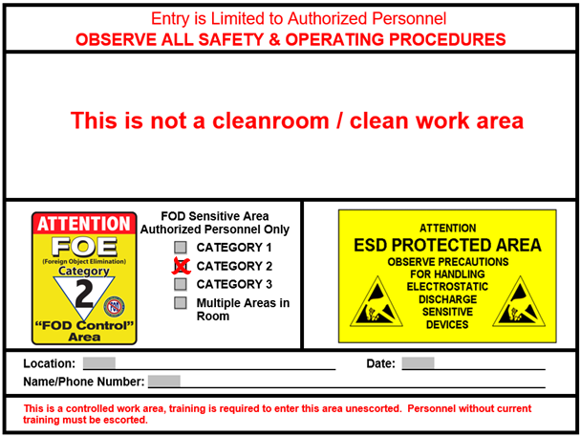
Building and Lab Facility Support Operations
If area personnel are not visibly available, area management contact information should be listed at the entrance of each lab/area.
When entering a lab/area please pay attention to all posted door signage and messages as they may contain important information needed to enter the premises.
Door Signage Example 1
Door Signage Example 2

Slide 5
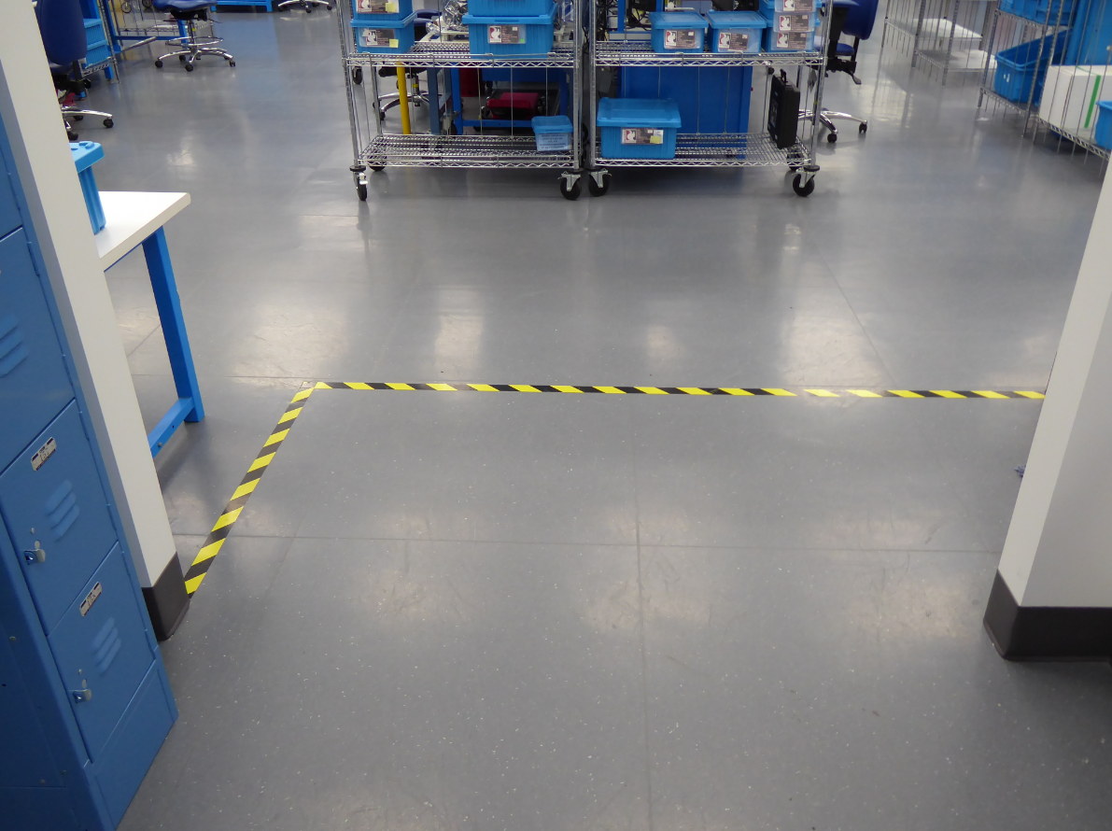
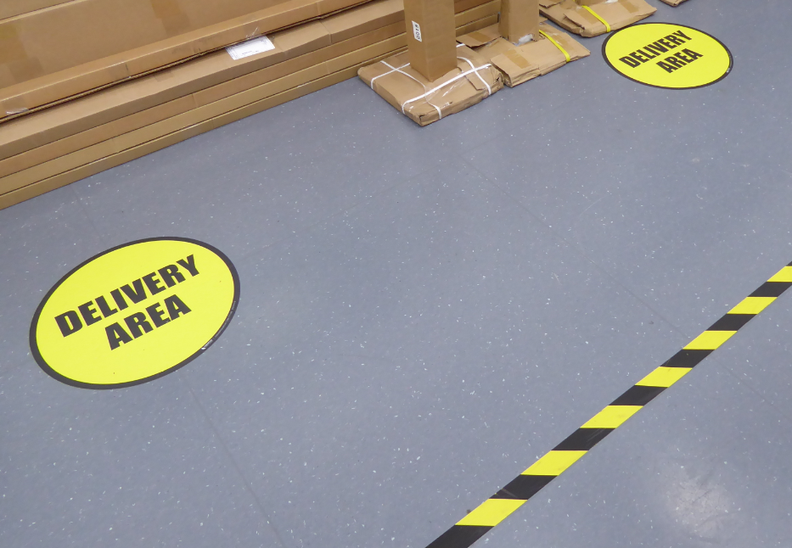
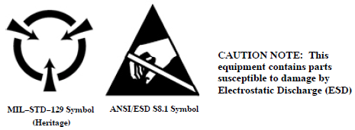
Building and Lab Facility Support Operations
Floor tape markings are used to indicate controlled areas and boundaries
Never enter an ESD controlled area unless authorized
Safety awareness and authorized entry zones may also be identified by multiple colored tapes or specific signs
ESD Controlled Area
Non-ESD Area
ESD Controlled Area
Some Labs have electronic components, parts, and assemblies that are treated as ESD sensitive items regardless of whether they are sensitive or not
ESD protective garments and grounding equipment must be worn at all times within an ESD controlled area (unless they may result in safety risks to personnel, such as during high voltage testing). Facilities services may not need special ESD garments, please check with area management prior to entering lab.
Only trained personnel are allowed to come within 3 feet of ESD workstations or exposed sensitive items
This is commonly referred to as “the three foot rule”
Designated Delivery Area
ESD Hardware Markings

