Slide 1

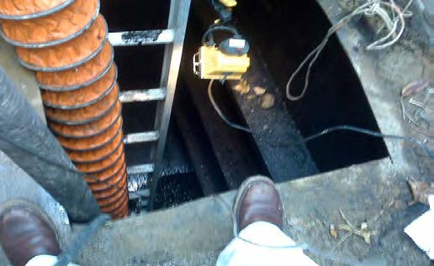
CONFINED SPACE
Understanding the Space Park Requirements
Jim Smith

Slide 2
AGENDA
What is a confined space?
What is a permit confined space?
Space Park confined spaces
What are the confined space requirements?
What are “permit required” confined space requirements?
What must be included on the permit?
What must a contractor submit to ESH&M for review?
Summary
This is an overview of contractor requirements and is not
a substitute for confined space training

Slide 3
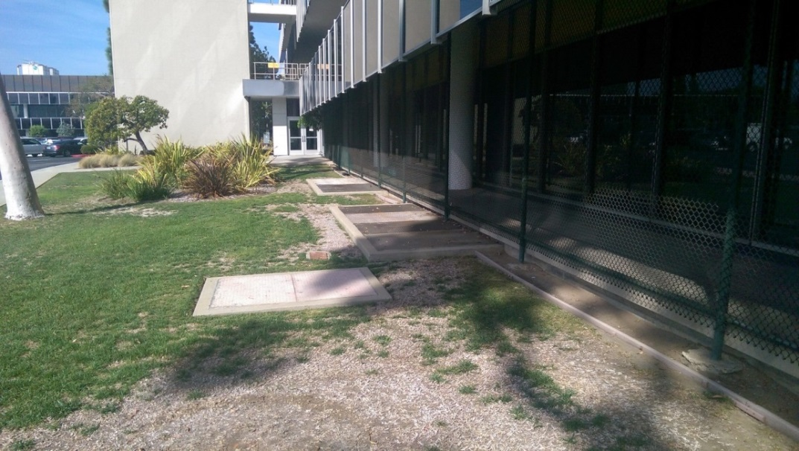
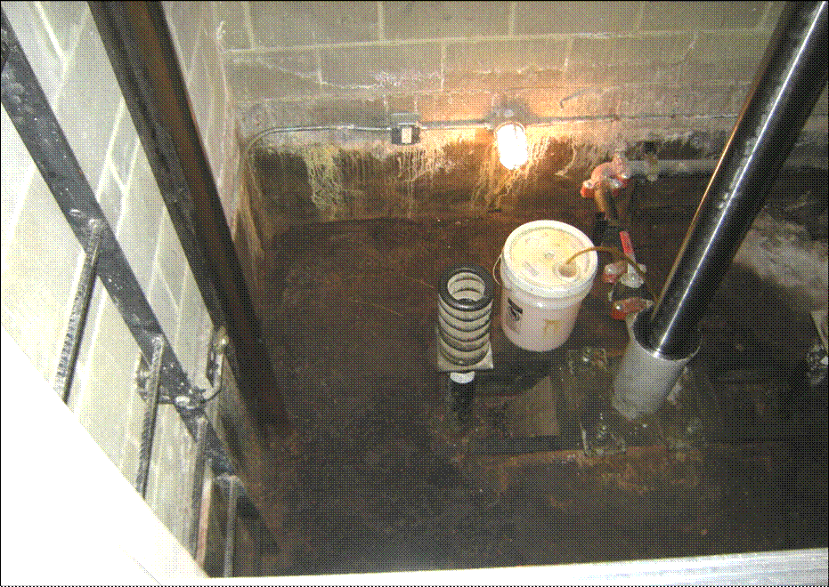
WHAT IS A CONFINED SPACE?
A confined space is:
  Large enough and so configured that a person can bodily enter;
  Has limited or restricted means of entry or exit; and
  Not designed for continuous occupancy.
E1 Air Wells
Elevator Pits
Notes:
If a worker cannot enter his/her/its entire body, then it is not a confined space per OSHA October 18, 1995 interpretation letter.
If a worker breaks any part of body which they can bodily enter, then it is considered entry.

Slide 4
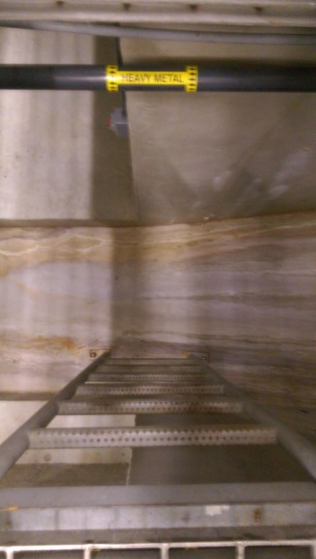
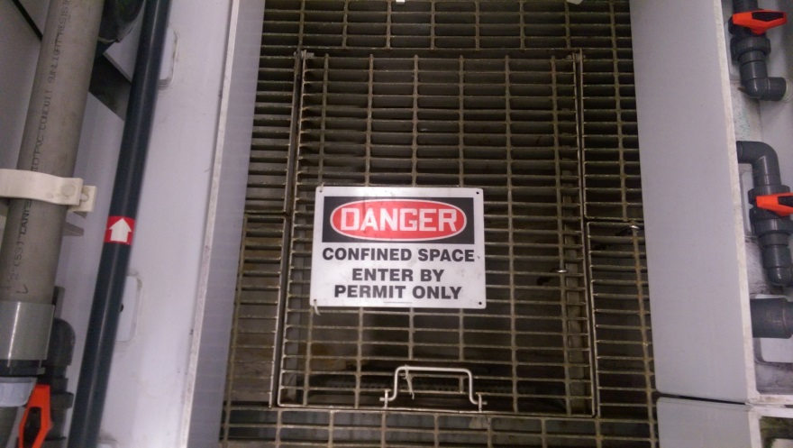
WHAT IS PERMIT REQUIRED CONFINED SPACE?
A space that meets the definition of a confined space and has one the following characteristics:
  Contains or has the potential to contain a hazardous atmosphere;
  Contains any material that has a potential for engulfing the entrant such as water or fine powder;
  Has walls which taper inwardly in which an entrant can be trapped; or
  Contains any other recognized health and safety hazard e.g. potential heat stress, live electrical equipment and unguarded machines.
M3 1153
(Lid Open)
M3 1153
Notes:
If the space contains only health and safety hazards and can be controlled, then the space can be re-classified as a non-permit space.

Slide 5
SPACE PARK CONFINED SPACES
All confined spaces at SP are identified as permit-required confined spaces.
Hence, all confined spaces shall be treated as permit-required confined spaces until evaluated at the location by a designated NG ESH (host employer), re-classified as a confined space in writing and justified by a contractor documenting air monitoring and inspection data that all hazards have been eliminated prior to and during the duration of entry.
Notes:
Not all permit-required confined spaces have been identified at SP.
All spaces must be considered permit-required confined spaces until the pre-entry procedures demonstrate otherwise.
Requirements apply when NG is supervising contractor whether or not on NG property.
Contractor utilizes their own air monitoring and other equipment.

Slide 6
CONFINED SPACE REQUIREMENTS
All physical, electrical or mechanical hazards are eliminated through engineering controls so the only hazard is an actual or potential hazardous atmosphere;
Competent person ensures personal are trained;
“Forced” air ventilation alone is required and is sufficient to maintain the space safe for entry, but control of atmospheric hazard(s) through forced ventilation does NOT constitute elimination and thereby the space will be designated as permit required;
Competent person collects initial air monitoring and is able to provide inspection data prior to entry;
“Periodic” air monitoring is collected during entry duration;
Inspection and air monitoring data is documented and signed by the competent person;
Rescue equipment is not required; and
Post the SP NG Notification Tag prior to entry.
Notes:
Competent person = Is able to identify existing or predictable hazards and has the authority to take prompt corrective action.
Contractor is not introducing atmospheric hazards – e.g. welding fumes.
The NG SP Notification Tag is obtained from the ESH&M Department.

Slide 7
PERMIT CONFINED SPACE REQUIREMENTS
Prior to entry, NG ESH informs the contractor of:
The hazards or potential hazards; and
Any previous contractor or host employer actions implemented for entrant protection.
The Contractor must ensure the:
Competent person or supervisor completes the permit;
Personnel are trained;
Rescue procedures are known and rescue equipment is available;
Permit and SP NG Notification Tag is posted at the entry;
Continuous “forced” ventilation is provided; and
Air monitoring conducted “continuously”.
Notes:
Contractor completes their own permit.
Duties of attendant and supervisor apply.
Contractor periodically documents air monitoring results on permit.
Competent person and supervisor can be the same person.

Slide 8
PERMIT CONTENTS
Purpose of entry;
Date and duration of entry;
List of authorized entrants;
Name of attendant and supervisor;
Acceptable entry and air monitoring limits;
Air monitoring results with competent person’s initials;
Physical and atmospheric hazards;
Controls such as LOTO and ventilation;
Communication method;
Emergency services phone no.;
Equipment such as type of PPE to be worn, air monitoring, and rescue; and
Any additional permits required such as hot work.
Notes:
Verify emergency service can conduct rescue entries.
Tripod must be available and harness worn by all entrants for vertical entries greater than 5 feet.

Slide 9
DOCUMENTATION
The following documentation is required by ESH to review at least 5 days prior to any contractor entry into a permit required confined space:
  Contractors confined space program;
    Procedure for confined space entry or re-classification of a permit required confined space entry
    Permit system for preparation, issuance and cancelation of permits
    Permit
    Safe entry procedures
    Rescue procedures
  Confined space training certificates;
  Electrical, fall protection, respirator FA/CPR or other training as applicable; and
  Calibration certificate for applicable air monitoring equipment.

Slide 10

SUMMARY
Confined Space
Must meet three conditions
Periodic air monitoring and
provide documentation on form
Document inspection on form
Competent person signs form
Rescue equipment not required
Permit-Required Confined Space
Meets one or more additional conditions
Continuous air monitoring and provide periodic documentation on permit
Document inspection on permit
Competent person signs the permit and ensures all contents are on the permit are addressed
Rescue equipment is available
What are some other requirements?
Notes:
Training is required for both.
Forced ventilation is required for both.
Attendants and supervisor duties are required for the permit-system.

Slide 11
REFERENCES
  Aerospace Sector Procedure, Confined Space Entry, KO-0805, September 2015.
  ESH&M Compliance Manual – Space Systems, August 28, 2014
  General Safety and Environmental Rules for Contractors, 7847, January 2014
  Confined Spaces in Construction, Subpart AA, effective August 3, 2015.
  OSHA Interpretation Letters and the Confined Space Advisor.

