Slide 1

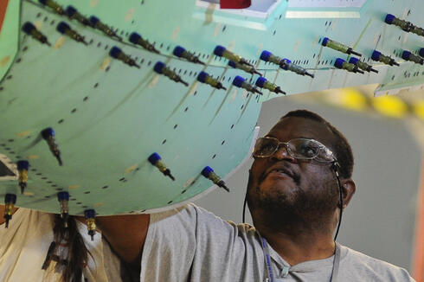
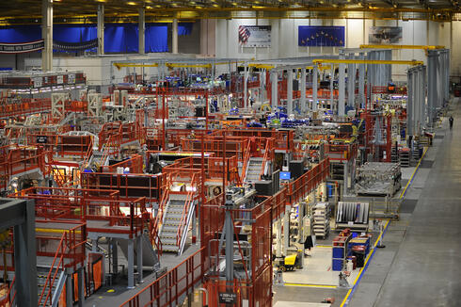
Aeronautics Systems Sector | May 2022
SUPPLIER QUALITY VISION Through collective engagement with suppliers, colleagues, and customers, Supplier Quality provides insight and cultivates a culture of first-time quality to ensure mission success. HAVE YOU TOURED THE NEW OASIS WEBSITE? www.northropgrumman.com/suppliers/ Visit OASIS for access to SQAR, Scorecards, and more! TOP 5 AUDIT FINDINGS (2021) Planning & Control - 46 Production & Service - 28 Documented Information - 27 Requirements for Products - 23 Control Nonconforming Output – 17 Interested in learning more about common findings? Ask your QFE! NONDESTRUCTIVE TEST (NDT) TECHNIQUE REQUIREMENTS NDT Procedures and Techniques may be required to be submitted to NGAS for approval. Review SQAR Paragraph 2.6 and SQARSUP-0120 Supplement for NDT Procedure / Technical Submittal for requirements REQUESTS FOR CHANGE / INFORMATION (RC/I) The RC/I form is available on OASIS for submittal of Technical or Contractual questions/issues to NGAS for formal response. Source Inspection Scheduling Reminder to contact your NGAS Quality Field Engineer (QFE) 48 hours in advance of need to schedule Source Inspection. Refer to SQAR Paragraph 2.3 | To Our Valued Supplier-Colleagues, 2022 – CONTINUOUS IMPROVEMENT Northrop Grumman Aeronautics Systems (NGAS) Supplier Quality (SQ) strives to build on the impressive supplier performance accomplished in 2021. SQ has a standing goal of enhancing operational efficiencies to ensure quality parts are delivered to production lines in a more timely and cost-efficient manner. We wholeheartedly embrace the “Team Concept” and encouragingly challenge our supplier-colleagues to constantly search for, and capitalize on, innovative opportunities to better meet demanding cost and schedule requirements. John Hunter, former Deputy Director for Web Operations in the Office of the Secretary of Defense Quality Management Office says, “Continuous improvement means that we never perceive current success as our own final achievement.” With last year in the rear-view, let’s all look forward to making 2022 another successful year. COMMITMENT TO QUALITY and compliance We are committed to First Time Quality and utilizes onsite audits across our supply base as a continuous improvement and escape prevention method. Our audit process is in place to provide confidence to our customers that suppliers have robust Quality Systems in place that are in compliance with customer, industry, and regulatory requirements. While audits may occasionally result in findings, robust and timely corrective action indicates a dedication to quality excellence and provides for continued future success. To best be prepared for an audit, review the SQAR document and ensure your organization is following documented processes to meet those requirements as well as AS9100 or the applicable industry QMS requirement. Thank you for your continued dedication to First Time Quality! | SQAR FOCUS – Foreign Object Debris/Damage (FOD) PREVENTION One of our most important requirements in aerospace business is FOD prevention. Historical data shows the smallest of foreign objects to be the cause of catastrophic aircraft incidents. Our customers depend on every supplier to hold in highest regard the FOD prevention requirements set forth in our SQAR to ensure the safety of the warfighters operating the final product. The following are requirements seen in the current SQAR (rev date 1/14/21): Supplier shall maintain good housekeeping to preclude introduction of, or damage to, any product/material caused by a foreign object(s) into any deliverable item. Supplier shall employ appropriate practices to assure timely removal of residue/debris generated during manufacturing operations or tasks. SQAR para 2.12 Supplier shall determine if sensitive areas that have a high probability for introduction of foreign objects/debris should have special emphasis controls in place for the manufacturing environment. Tool and Hardware accountability methods shall be established to ensure positive control and accountability, as applicable. SQAR para 2.12 OUR COMMITMENT John C. Maxwell, a published author on high-performing teams and organizational effectiveness, says, “teamwork makes the dreamwork.” Thank you for your continued contributions and commitment. Our collective success is a result of how we pull together as one team. Let’s make the next quarter even better, together.
Notes:
Rev 2:
Per Contract / Business Management review - Changed “Supplier-Partners” to “Supplier-Colleagues” x2; changed “Our Partnership” to “Our Commitment”; changed “contributions and partnership” to “contributions and commitment”; changed partners to colleagues (in grey text under supplier vision)
Updated "NGAS is committed" to " We are committed" and "a NGAS audit" to "an audit" in the Commitment to Quality and Compliance section. Text in grey column area changed to Arial font to match the same style of text in rest of newsletter. Per Comm Review.

